Slide 1
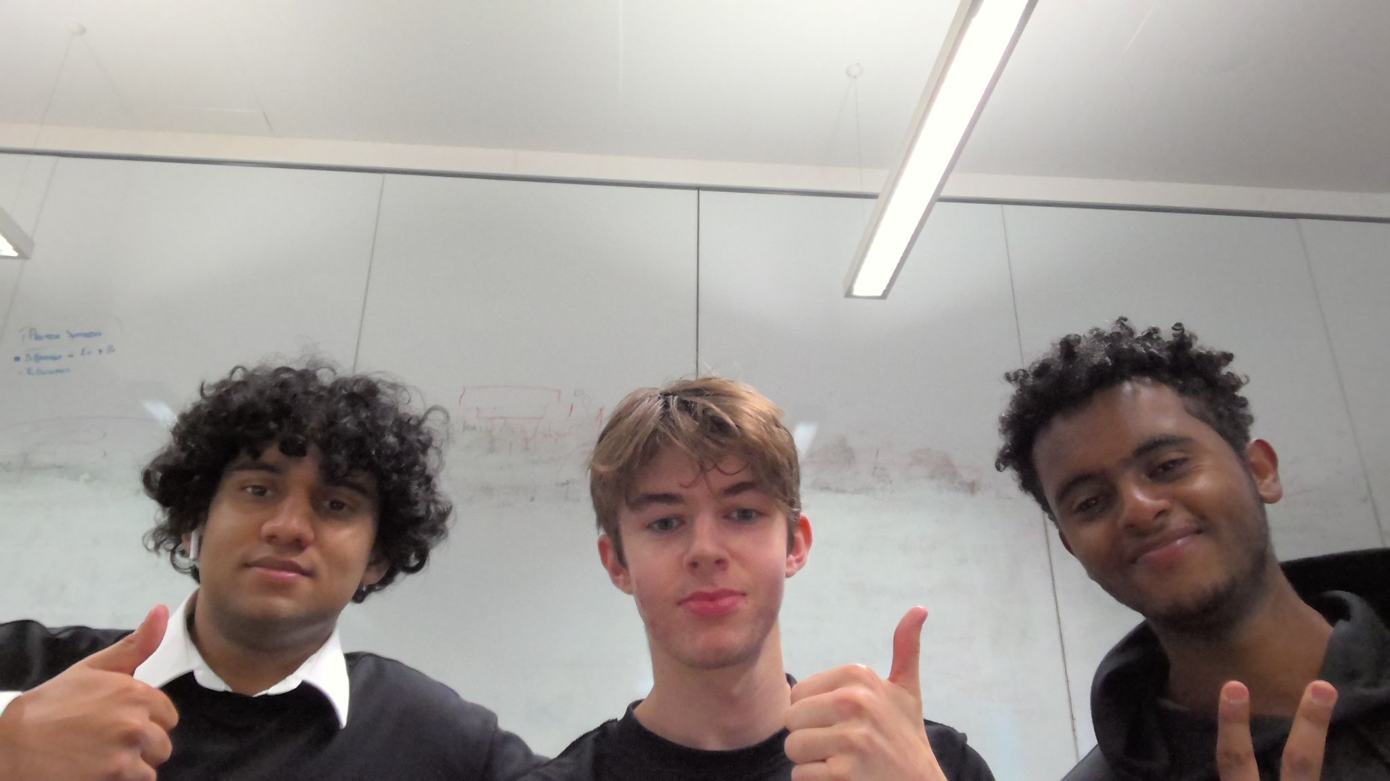
Dream Team COS10026
Project part 2
By Remy Amor, Amanuial Ashagrie, William Anthony

Slide 2
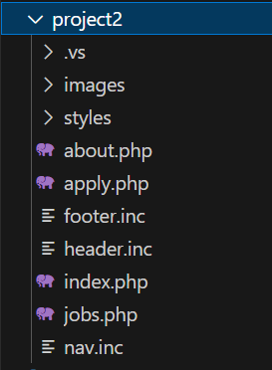
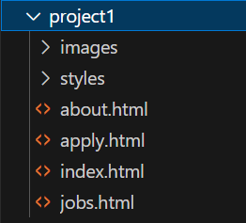
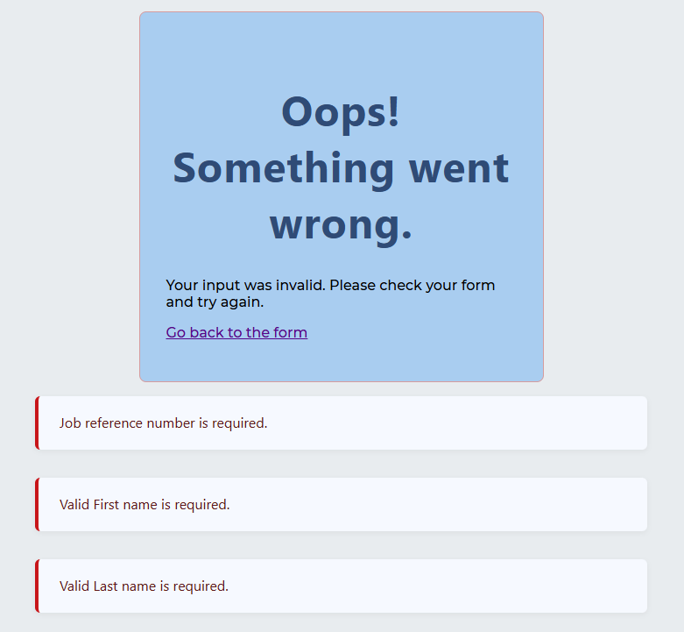
Introduction - Aman
Contributions
Transforming HTML files to PHP files
Developing and Incorporating Header, Footer and Nav INCLUDE files,
Header and Footer further styling,
Developing process_eoi.php that
processes all Expressions of Interest,
Carries Server Side validation of all user inputs,
Development error_page.php that
That redirects user when attempting to apply with invalid input

Slide 3
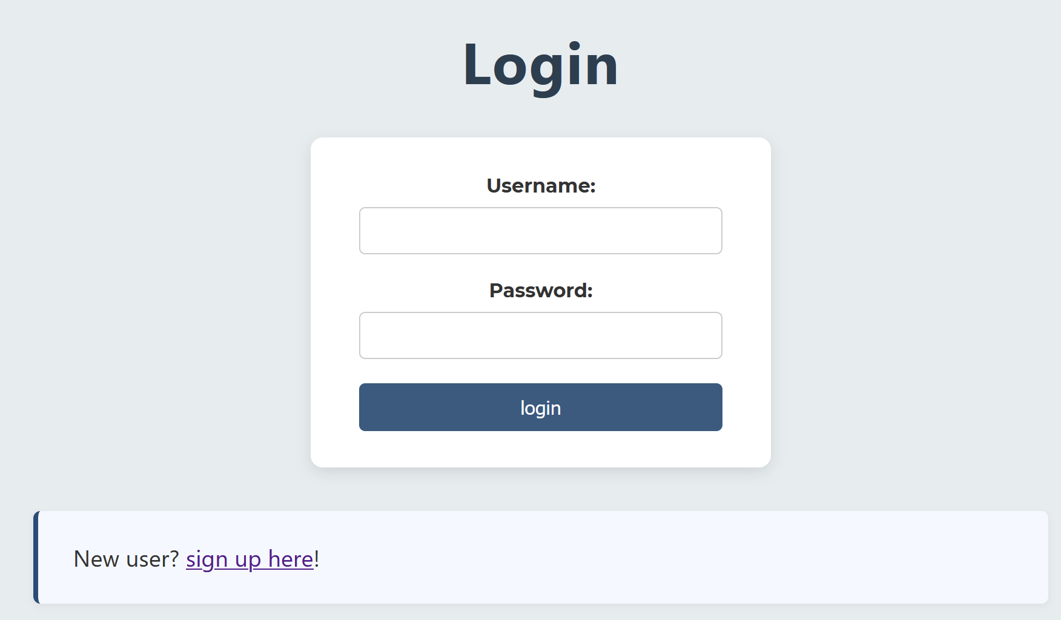
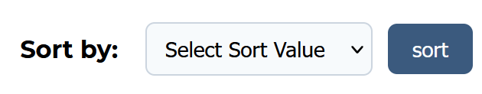
Introduction - Remy
Contributions
Manage page
Signup and Login authentication with signout
3 strike login attempt lock
EOI record sorting and display
settings.php
Organising consistency for database names
Dynamic Job Reference Number listing in dropdown menus

Slide 4
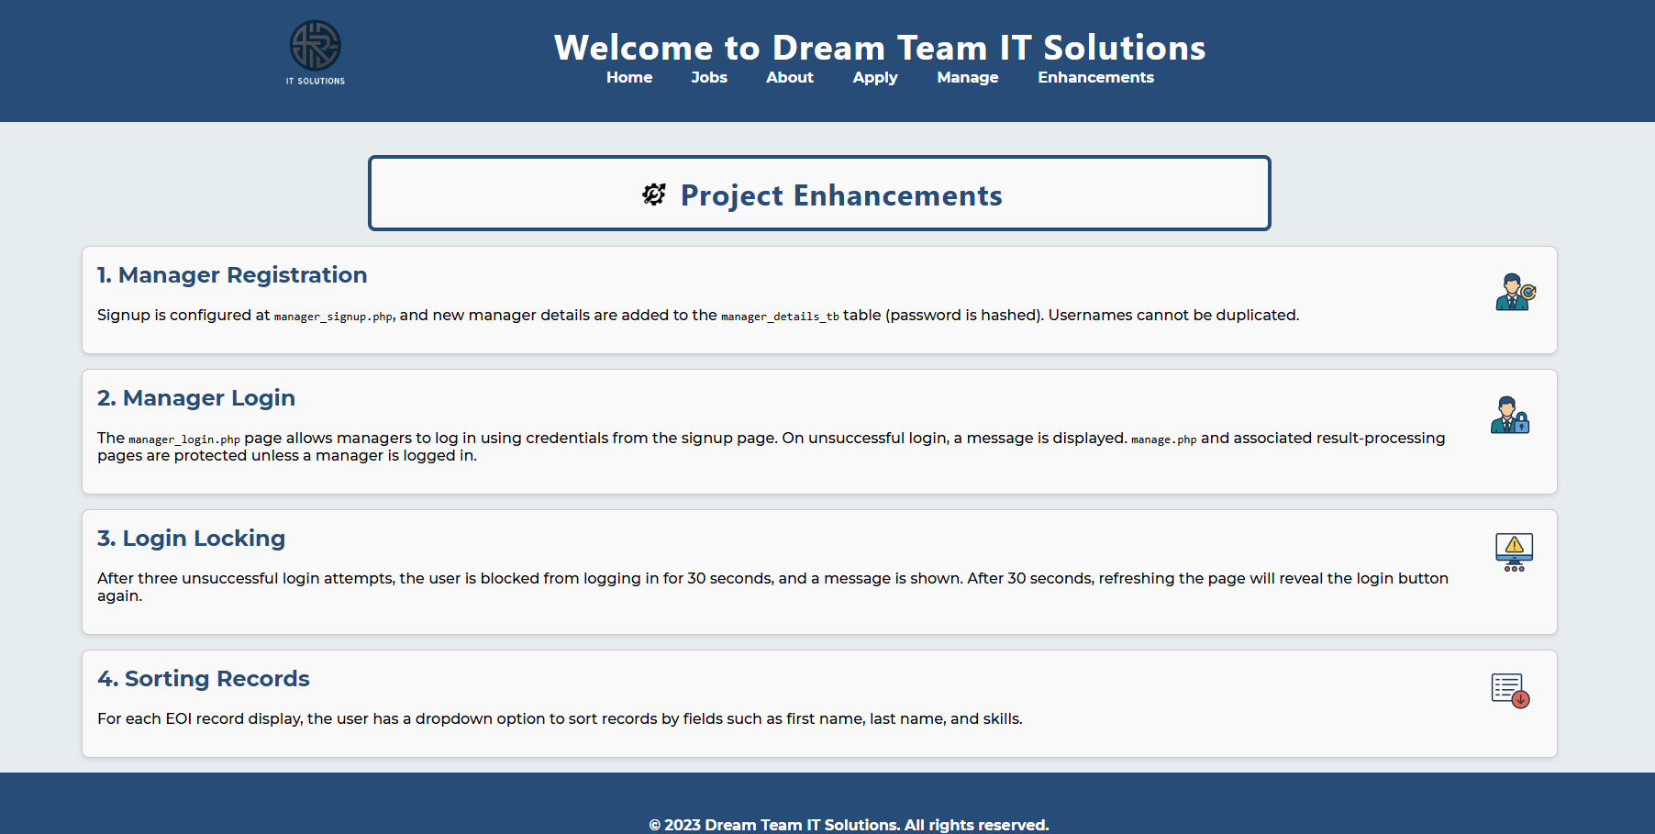
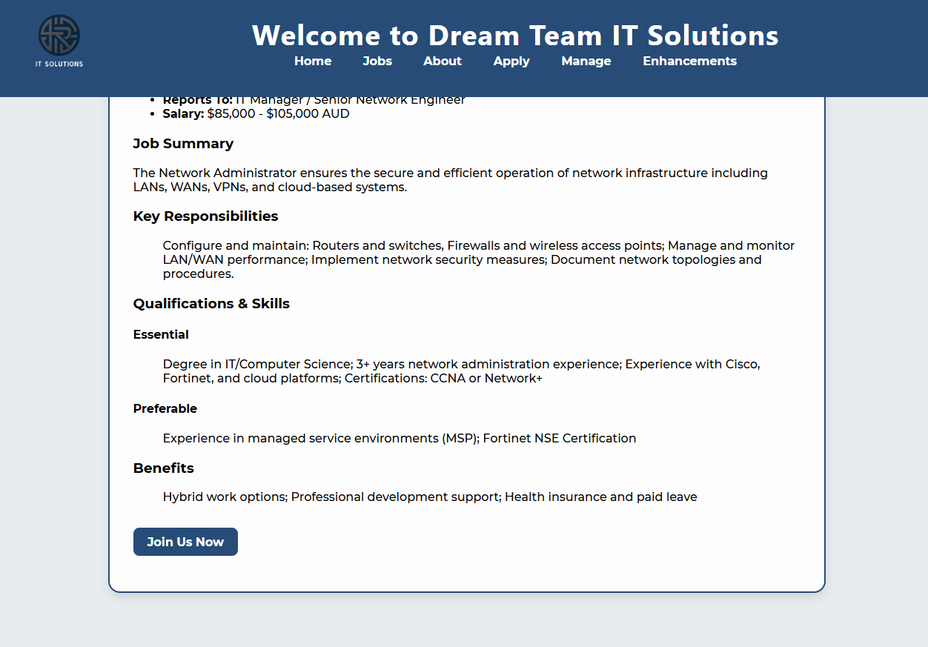
Introduction-William
Contributions:
Creation of company logo and subsequent images on the enhancements page
Creation of Jobs page and the back-end of the Enhancements page.
Further styling of jobs and enhancements page
Creation and implementation of jobs MYSQL table

Slide 5
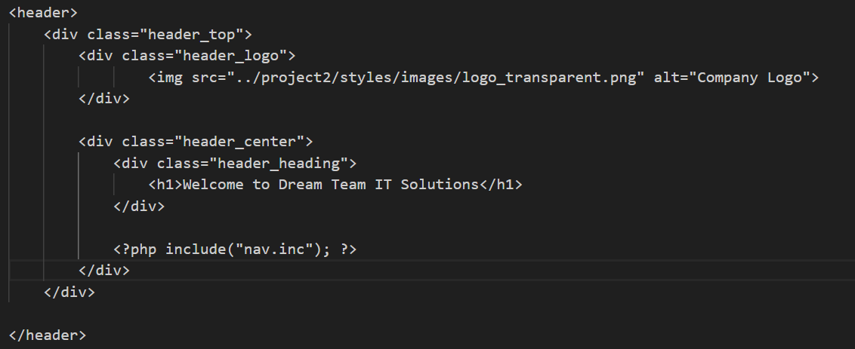
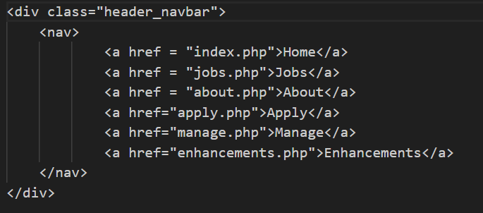
Development Process - Aman
Header, Footer and Nav Bar

Slide 6
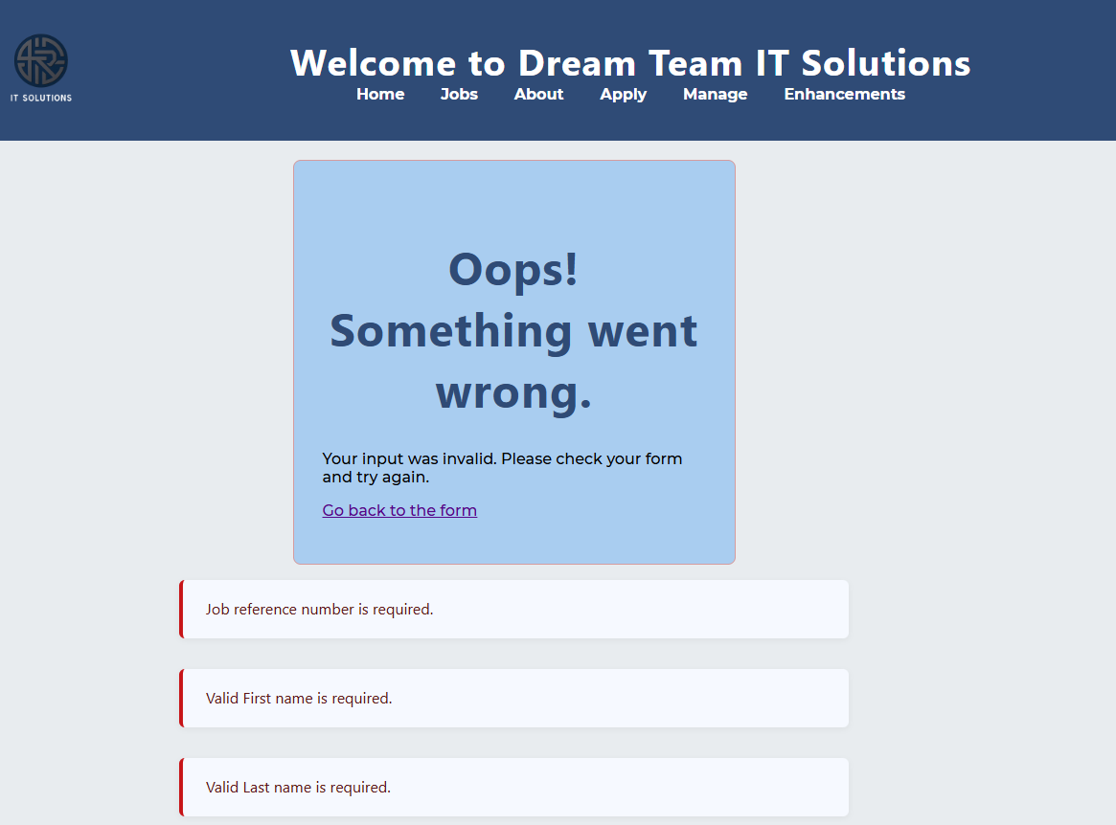
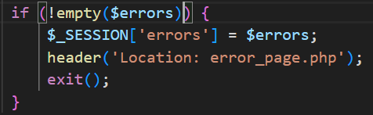
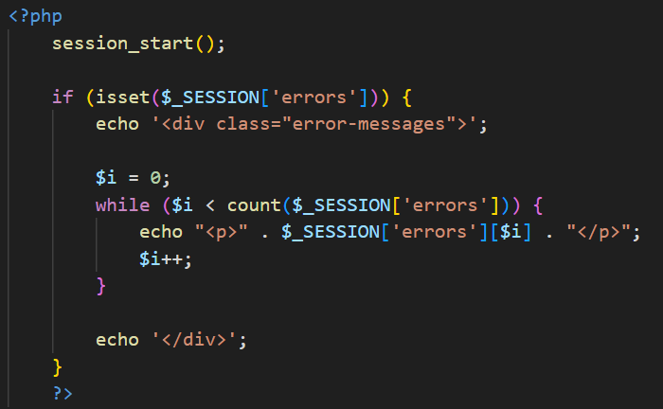
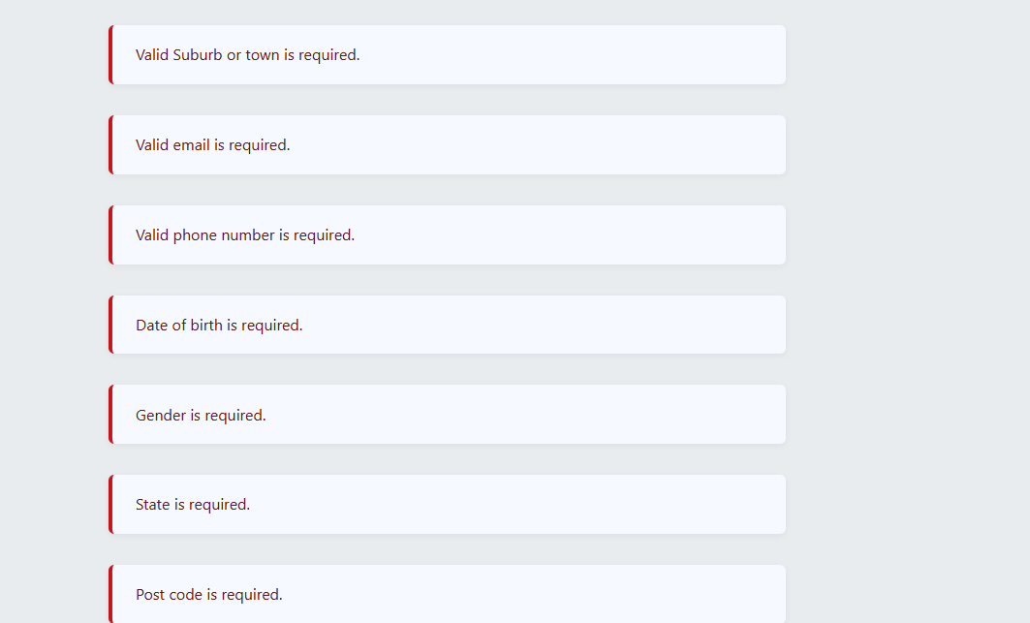
Development Process
Error Page
Using a PHP session, I was able to temporarily store which specific inputs caused validation errors. These errors were then accessed and displayed on a separate page to inform the user, and cleared only when the user returned to the form.

Slide 7
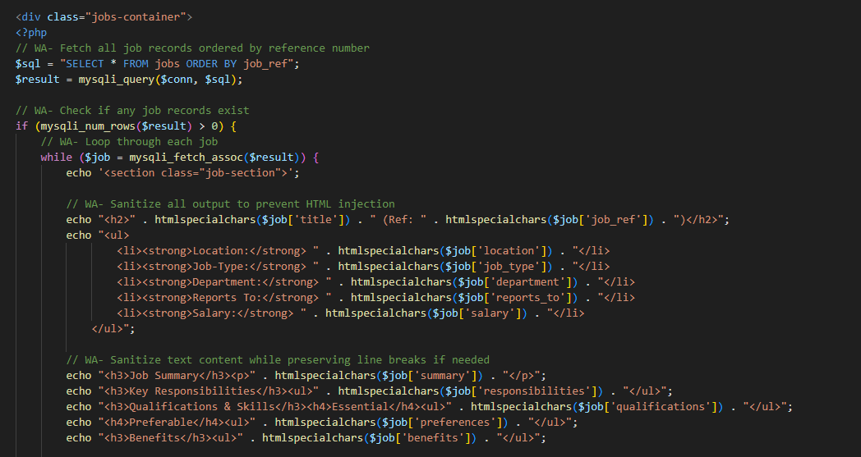
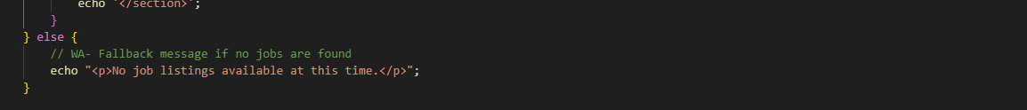
Development Process - William (Making a dynamic jobs page)
Some of my work was with php, however this came to be my favourite section. Using a php session I was able to access the data stored in the table “jobs”. Then using this data, I was able to echo out the relevant material as the job description on a loop. Looping as many times as there are robs in the table
If there were no rows in ‘jobs’ an if else statement would display the relevant message

Slide 8


Development Process - Remy
Backend - PHP, MySQL
A majority of my work was in PHP and MySQL, with php being used to connect to the MySQL database, input and output records dynamically, and authenticate users.

Slide 9
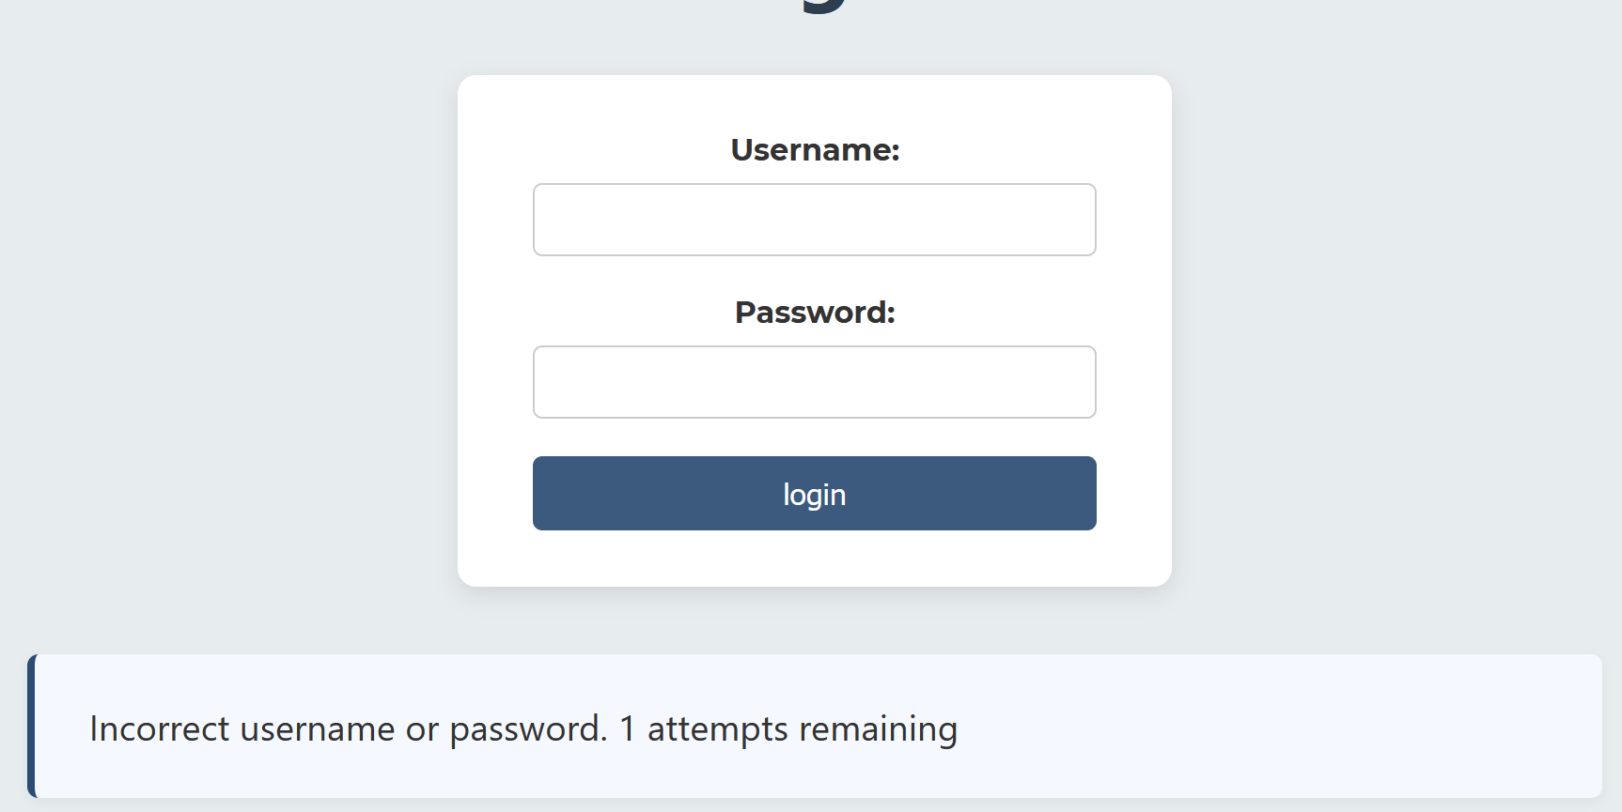
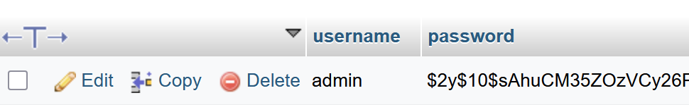
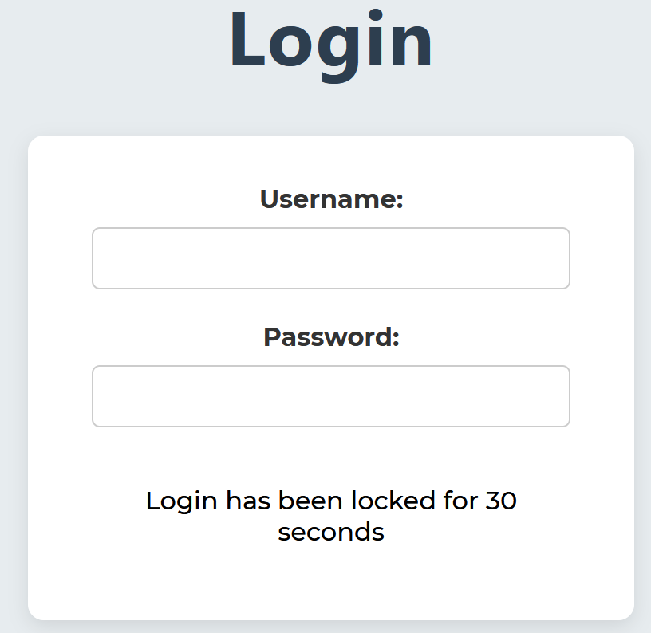
Development Process - Remy
Backend - PHP, MySQL
My favourite part was configuring the login and signup. I had to learn how to use password_hash() and mysqli functions, and solve the issue of how to keep track of login attempts using $_SESSION variables.

Slide 10

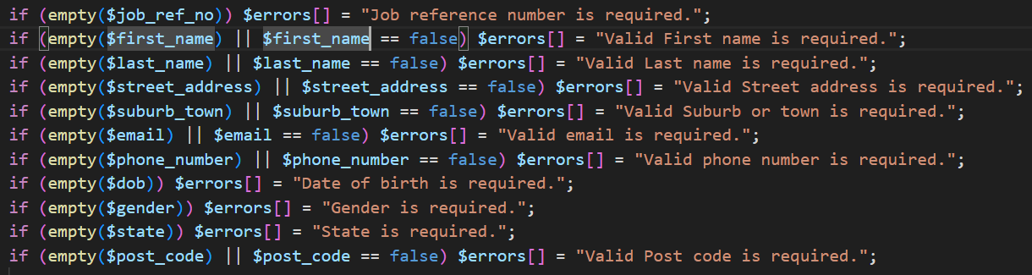
DataBase Interaction - Aman
Server side validation
After Sanitizing and Validating all inputs :
Redirect to Error Page
Store which inputs are causing errors -
Inject Into Database
If all Inputs are Valid and not malicious, add the following values into Database -

Slide 11
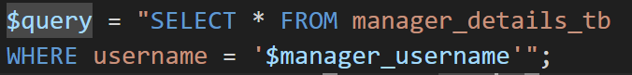
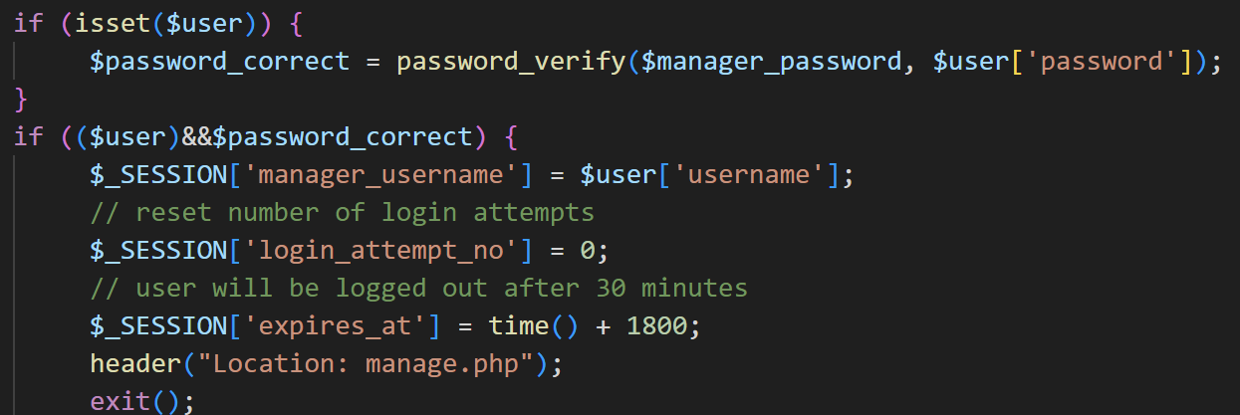
Database Interaction - Remy
EOI & Manager Details Table
My interaction with the database involved retrieving, displaying, changing and deleting EOI records from the eoi_tb according to the managers needs.
I also authenticated manager
Details and inserted new manager
logins.

Slide 12
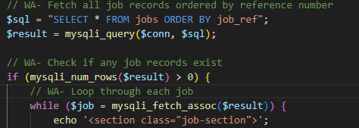
Database interaction - William
My data base interactions were primarily focused on the jobs page
jobs.php – Database Interaction Summary
Connects to the MySQL database via settings.php
Performs a SELECT * FROM jobs to fetch all job listings
Dynamically loops through each job record
Outputs each job as a formatted HTML section

Slide 13
Conclusion - Remy
During this project and from my contributions I learned about:
Using PHP and understanding how it functions in relation to MySQL
SQL Databases and query structure
Working on databases collaboratively and avoiding redundancy during development
The important role that backend development has in creating dynamic, functional websites.
Big thanks to my teammates for their hard work and communication 😁

Slide 14
Conclusion - Aman
Teamwork makes Dream Team Work
The following are some of the key skills I have developed with this project which I intend to apply into my future real-world projects.
Collaborating effectively with team members on same project
Communicate clearly and consistently
Effectively Utilize collaborative tools such as Github and Jira which are very much used in the industry
Having understanding and experience in various aspects of website development
From Designing and Styling Web page
To creating a databases that allows for efficient storing and access of data
ps. dream team

Slide 15
Conclusion - William
The entire project has been a learning experience, the following are what I believe are the most important:
Understanding what php and MYSQL are and how when used in conjunction they are able to make a dynamic modern website
Learning how to write more efficient code with modularity in order to decrease development time
Learning the importance of effective and timely communication within a group setting
Management tools such as jira and collaborative tools such as git hub and discord
Thank You to my Teammates Remy and Aman for their tenacious attitudes, hardwork and communication

Slide 16

Thanks!

